Slide 1
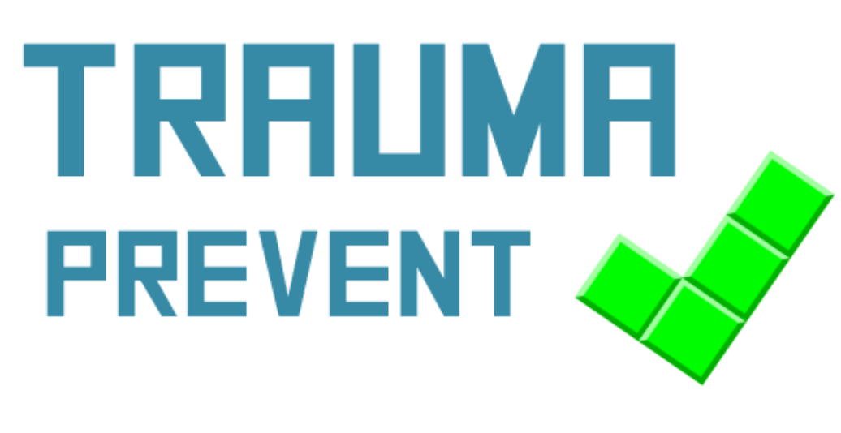
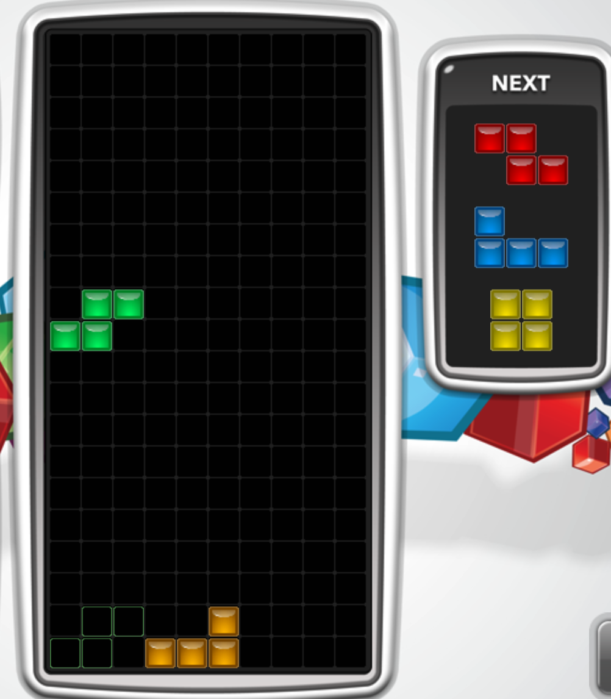

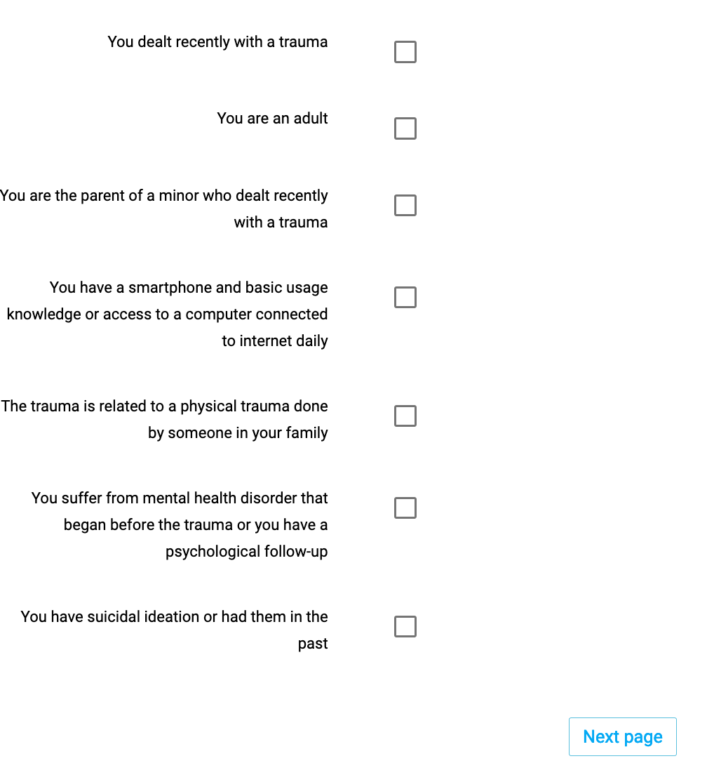
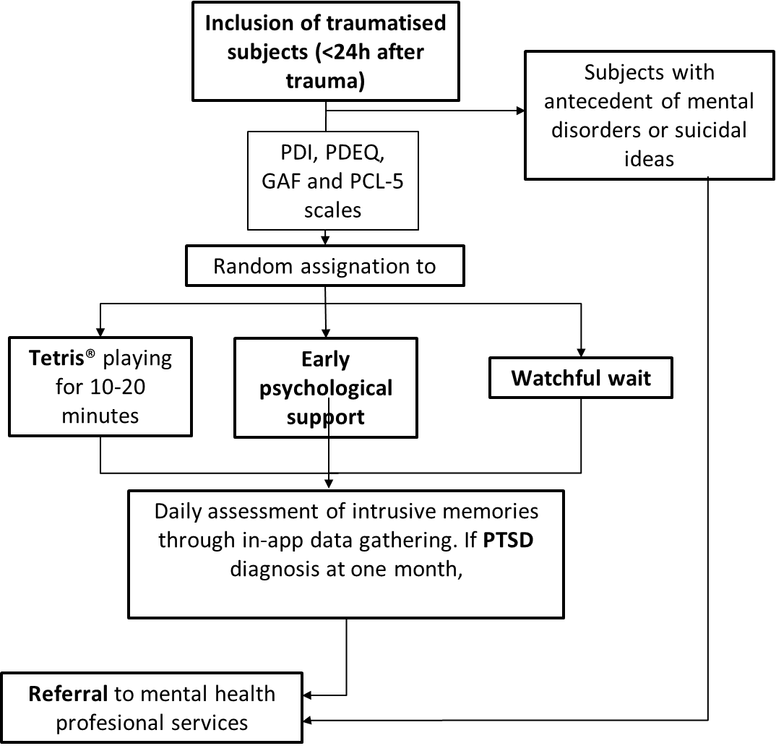
Preventing Post Traumatic Stress Disorder induced by trauma during the COVID pandemic
A simple brief intervention based on cognitive science that could be delivered digitally
Authors: Ó. Soto-Angona*, T. Gargot**
* Department of Psychiatry, Hospital Universitary Vall d’Hebron, Barcelona, Catalonia, Spain
** Child and Adolescent Psychiatry, CHRU Tours, France
INTRODUCTION
In the Wuhan region in China, Liu et al., reported a prevalence of 7% Post Traumatic Stress Symptoms (PTSS) after COVID (Liu, 2020). Including only the COVID-19-infected population, Bo et al. found a PTSS prevalence of 96.2% (Bo, 2020). Identified risk factors influencing symptoms and transition to PTSD are :
A) Pre-trauma: (1) female sex, (2) less than secondary education, (3) prior interpersonal trauma, (4) prior mental illness
B) Peri-trauma: current exposure type (interpersonal) or severity
C) Post-trauma: (1) early symptom configuration or severity - Peritraumatic dissociation, (2) memory of the event, (3) Heart rate measured in emergency department.
These factors could be identified easily to screen the most at-risk population, and some basic interventions could be applied to avoid further development of PTSD
FormR (Fig 3), a survey framework allows to:
(1) chain simple surveys into long runs,
(2) screen inclusion and exclusion criteria,
(3) randomize subjects,
(4) redirect subjects to external ressources
This complex designs framework looks suitable to implement our solution
Trauma due to the COVID pandemic seems to be a prevalent event that could develop to post-traumatic stress disorder if not properly managed. Some simple measured begin to have proven efficacy and could avoid further complications.
We have designed an online multi-centric study aimed to test an app that would:
Screen for post-traumatic stress symptoms
Educate the population on management and identification of such symptoms
Deliver and test three different approaches to deal with such symptoms.
ABSTRACT
Fig 1. Tetris®, a vídeo game requiring a visuo spatial effort
CONCLUSIONS
Trauma-Prevent could be a useful tool for the general population in order to manage trauma due to COVID. It could allow to screen for subjects requiring professional help, and might avoid further complications of such trauma by delivering simple, effective measure aimed to impair trauma consolidation and to avoid the development of PTSD
METHODS AND MATERIALS
Fig 2. Flowchart of the proposed study
Three solutions are considered during the acute phase (golden hours, <24h) after trauma to prevent transition from PTSS to PTSD, with limited evidence favoring one over another :
(1) Tetris® use (Fig 1) (Iyadurai, 2018 ; Iyadurai, 2019)
(2) Early psychological support (Rose, 2002)
(3) Watchful wait
The use of Tetris® has been assessed in cognitive science: using spatio-visual tasks during an acute phase prevents memory consolidation of a traumatic event (Kavanagh, 2001). In contrast, verbal tasks, increasing memorization, should be avoided. Tetris®’ use has been tested in small-sample clinical trials showing feasibility and efficacy in preventing intrusive memories, yet replications are needed in a larger population and with a longer follow-up. Furthermore, a survey showed a good acceptability among traumatized subjects.
We are implementing a web-based smartphone application (Fig 2)
that could
(1) Collect data enabling to predict and follow the evolution of PTSS toward PTSD,
(2) Assess the relative efficacy of several methods to prevent the evolution of PTSS right after exposure to trauma (1-24h).
(3) Educate people about psychological effects that can occur during and after trauma, normalize acute distress and suggest that they seek professional help if they still experience substantial PTSS one (or more) month after the traumatic event, which defines PTSD.
CONTACT
REFERENCES
Óscar Soto Angona
Email: osoto@vhebron.net
Dr Thomas Gargot, MD, PhD std Computer Science
Email: Thomas.gargot@uni-tours.fr
Phone: +34667909711
Website and sources: https://devpost.com/software/proto-trauma-prevent
Bo, H., Li, W., Yang, Y., Wang, Y., Zhang, Q., Cheung, T., . . . Xiang, Y. (2020). Posttraumatic stress symptoms and attitude toward crisis mental health services among clinically stable patients with COVID-19 in China. Psychological Medicine, 1-7. doi:10.1017/S0033291720000999
Iyadurai, L., Blackwell, S. E., Meiser-Stedman, R., Watson, P. C., Bonsall, M. B., Geddes, J. R., ... & Holmes, E. A. (2018). Preventing intrusive memories after trauma via a brief intervention involving Tetris computer game play in the emergency department: a proof-of-concept randomized controlled trial. Molecular psychiatry, 23(3), 674.
Iyadurai, L., Visser, R. M., Lau-Zhu, A., Porcheret, K., Horsch, A., Holmes, E. A., & James, E. L. (2019). Intrusive memories of trauma: a target for research bridging cognitive science and its clinical application. Clinical psychology review, 69, 67-82.
Kavanagh DJ, Freese S, Andrade J, May J . Effects of visuospatial tasks on desensitization to emotive memories. Br J Clin Psychol 2001; 40: 267–280.
Liu, N., Zhang, F., Wei, C., Jia, Y., Shang, Z., Sun, L., … Liu, W. (2020). Prevalence and predictors of PTSS during COVID-19 outbreak in China hardest-hit areas: Gender differences matter. Psychiatry Research, 287, 112921. doi: 10.1016/j.psychres.2020.112921
Rose, S. C., Bisson, J., Churchill, R., & Wessely, S. (2002). Psychological debriefing for preventing post traumatic stress disorder (PTSD). Cochrane database of systematic reviews, (2).

